Slide 1
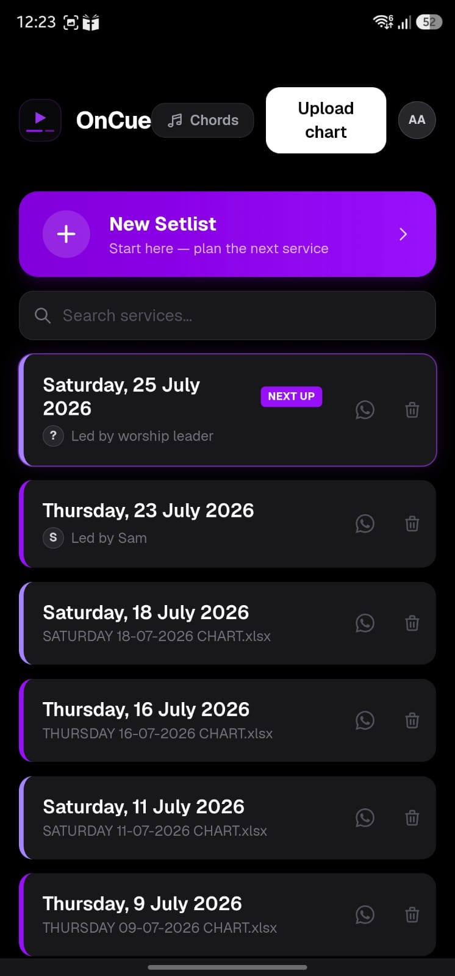
Worship leaders have the option to create setlists

Slide 2
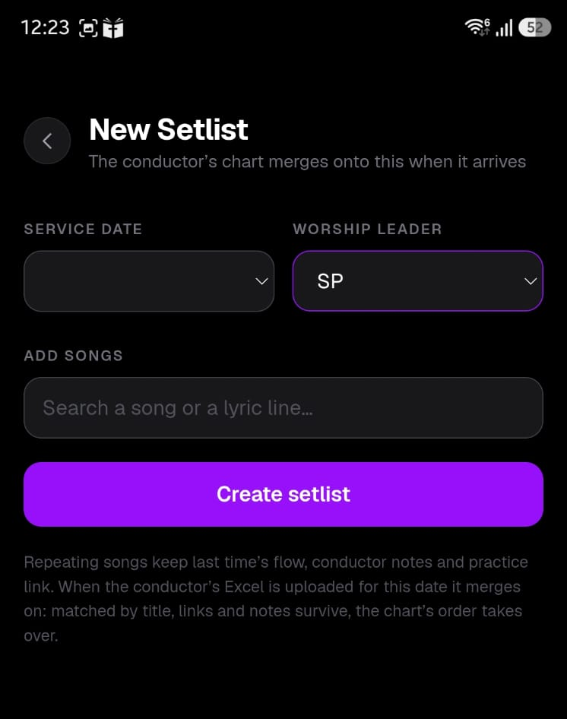
The person creating the setlist will automatically be assigned as that Worship leader for the setlist, or you can change manually

Slide 3
Click here to select the service date

Slide 4
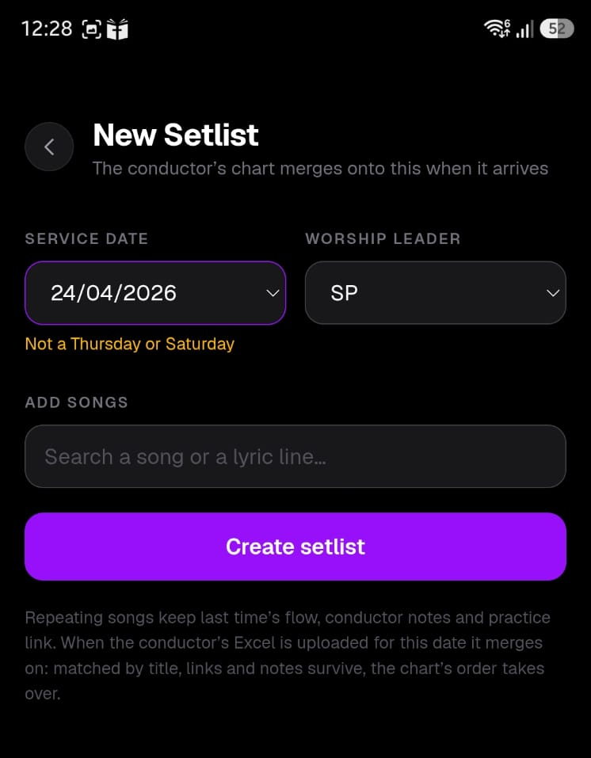
If a non-service day is selected, it’ll flag it

Slide 5
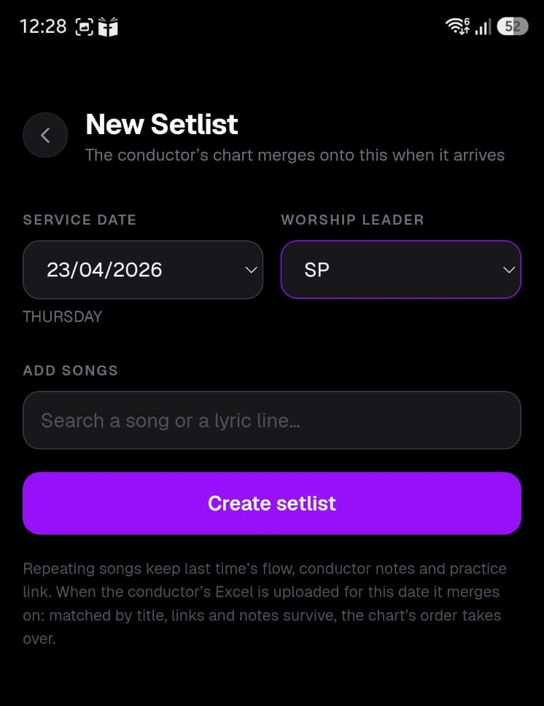
Type the songs for the setlist here

Slide 6
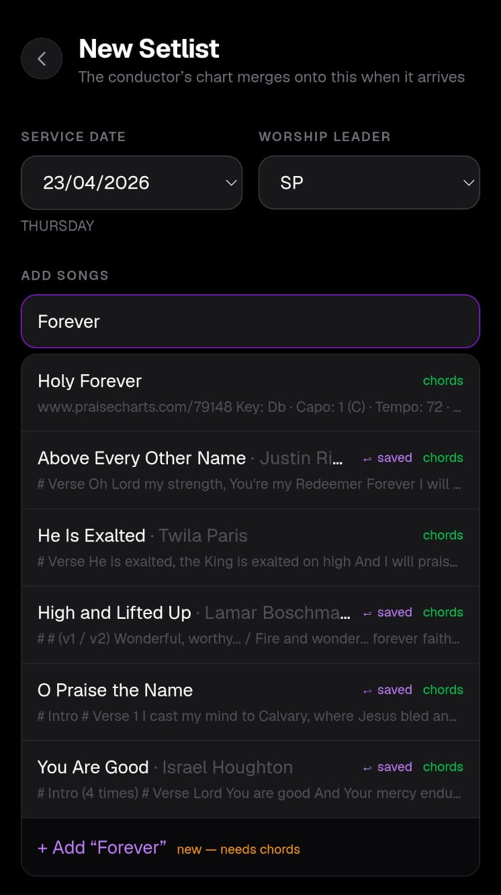
When you type, it’ll pull up all existing uploaded songs which have the keywords in the title or lyrics
If the chords for the song have not been uploaded, the song won’t be in the list.
Just click on +Add

Slide 7
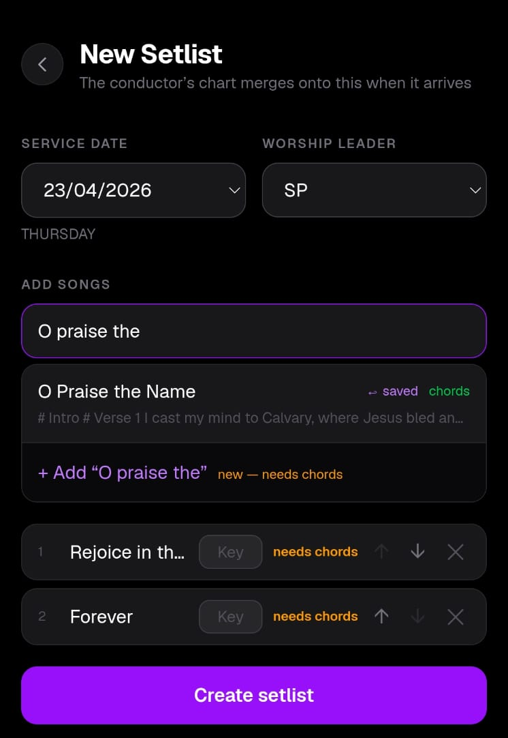
If the chords for the song have been uploaded, you can select it from here.
Starting Lyrics are listed for reference

Slide 8
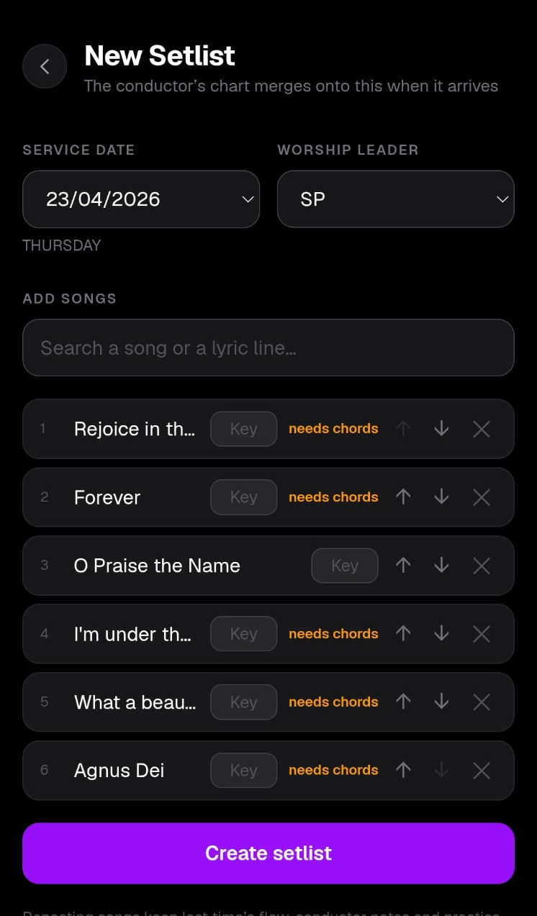
Once the setlist is complete, you can enter the Scale/Key for the songs here
Songs without chords uploaded will flag saying “needs chords”

Slide 9

After verifying the list, You can then click on “Create setlist”

Slide 10
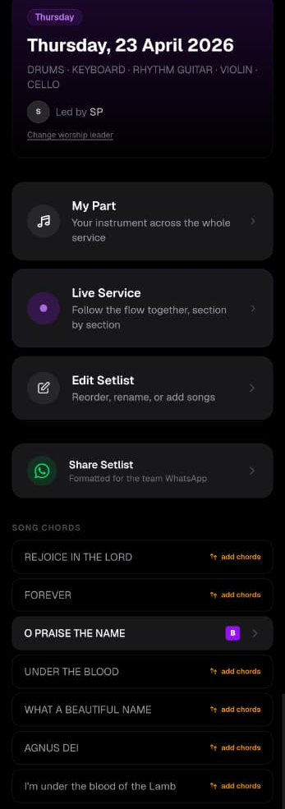
The setlist is now ready
You can make any changes to the setlist here
You can upload the chords for the songs that don’t have them if available

Slide 11
The setlist is now ready
And once you’re ready to share the setlist on the Whatsapp group, click here

Slide 12
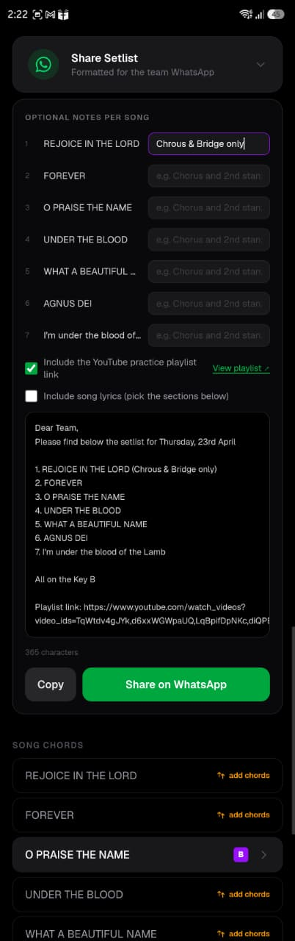
You can add any notes against individual songs
The notes will be visible in the WhatsApp message
Scales will automatically pull from the Setlist

Slide 13
A YouTube playlist is automatically created for the songs based on past records.
You can include/exclude the playlist in your message here
You can view the playlist here
You can see it in the message here

Slide 14
If chord sheets exist, you can include the song lyrics at the end of your message by checking this box

Slide 15
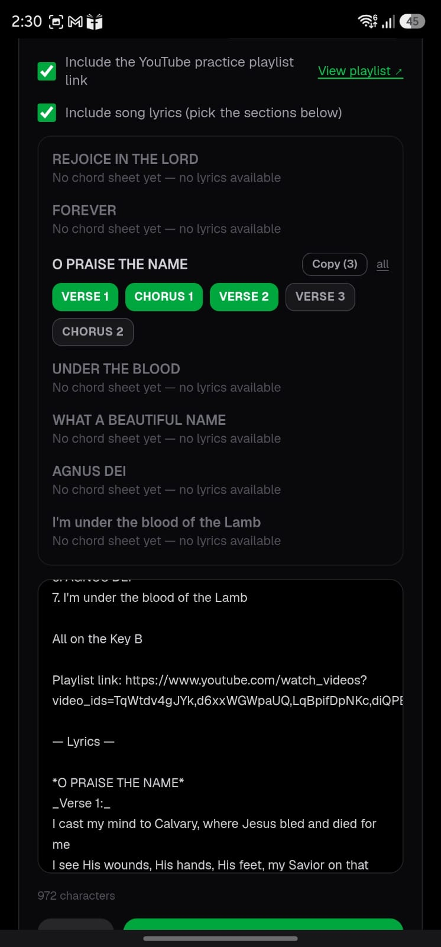
Select which parts of the song you want to include
Scroll here to see the message

Slide 16
From here you can either Copy the message, or click on “Share on WhatsApp” and it’ll draft the message in the WhatsApp chat

